Slide 1
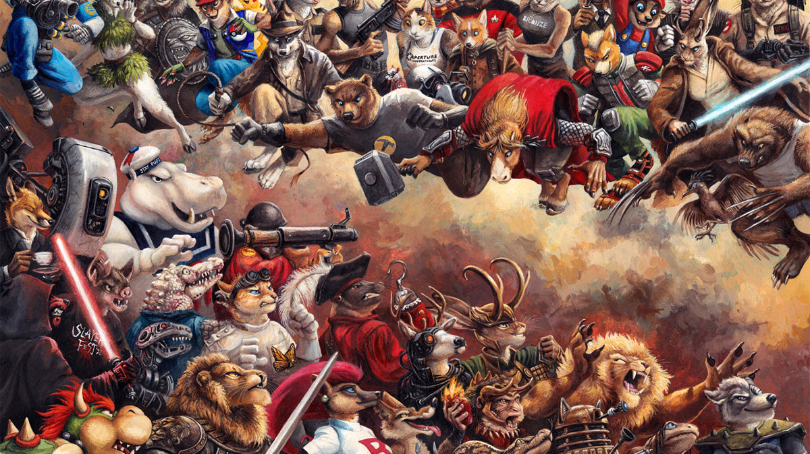
Anthropomorphic
Subculture
(AKA the Furry Fandom)

Slide 2
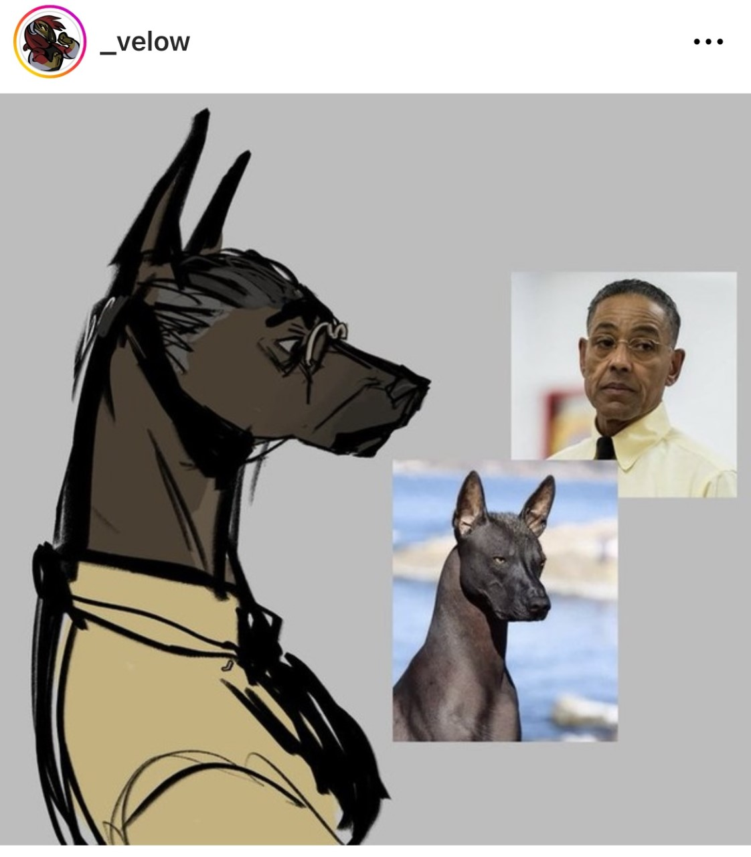
What is Internet Subculture?
Subculture:
A cultural group within a larger culture, often having beliefs or interests at variance with those of the larger culture (i.e., music genres such as Jazz or House)
Internet Subculture:
A culture where members use the internet as a main method of communication (i.e., Gamers, Otaku, Cosplay)
Fandom:
The fans of a particular person, team, fictional series, etc. regarded collectively as a community or subculture. (i.e., “The Breaking Bad fandom“ or ‘’The One Direction fandom’’

Slide 3
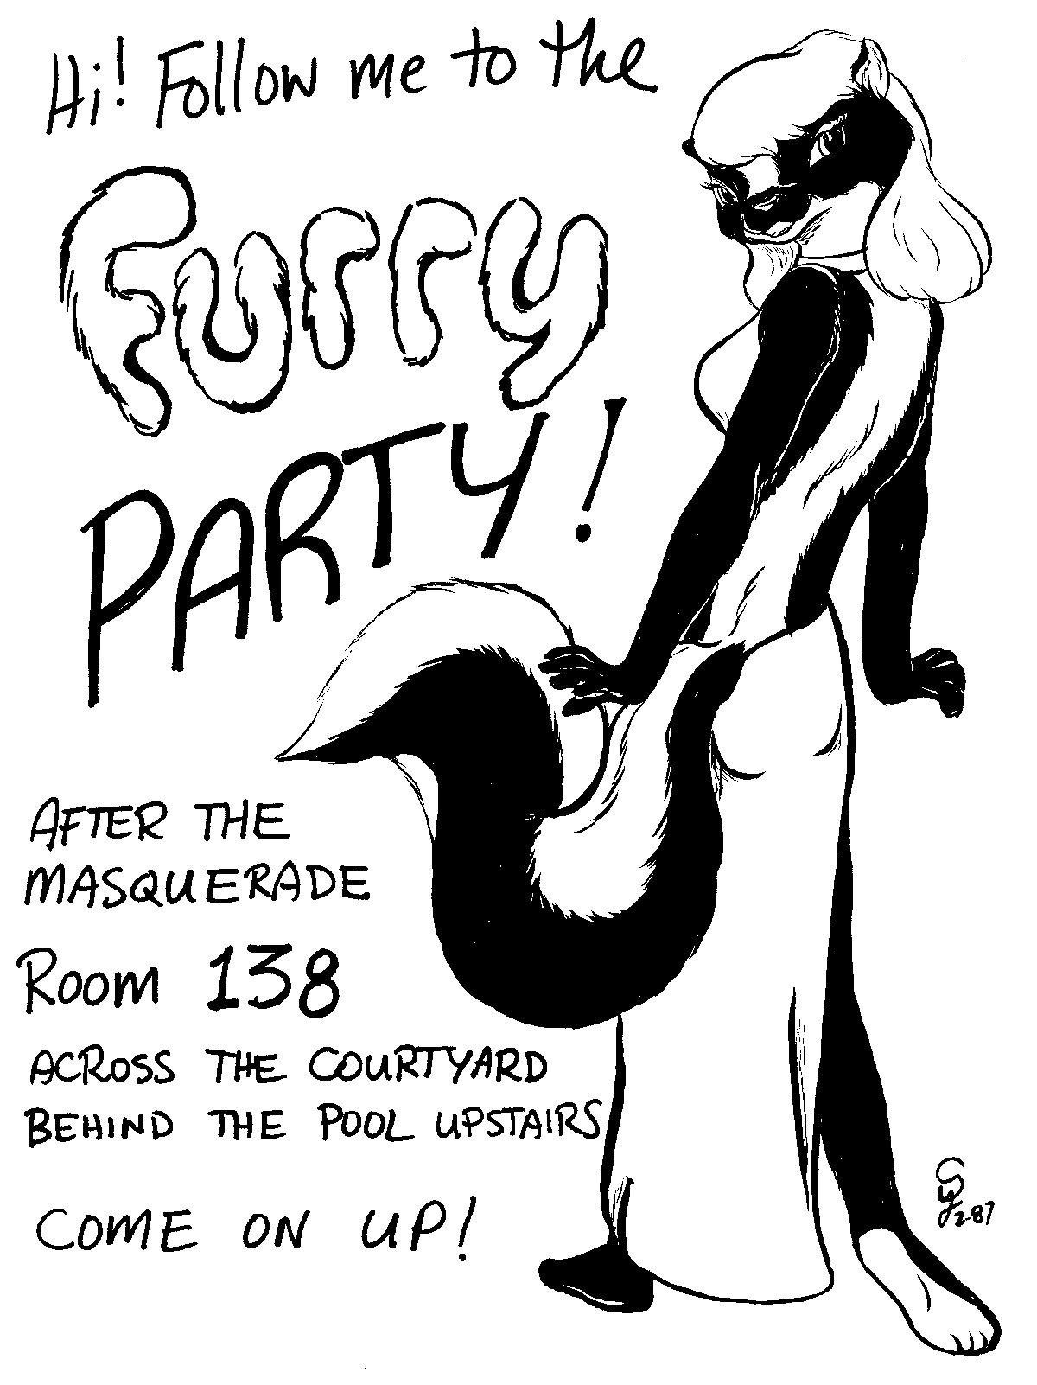
What is the Furry Fandom?
“The organized appreciation and dissemination of art and prose regarding 'Furries', or fictional mammalian anthropomorphic characters.’’
Artists, writers, performers, musicians, suiters, gamers, role-players, average Joes
Began in 1983 with fanzine creators, started to flourish throughout the 90s
Established very heavily online since the dawn of the web
One of the most prominent subcultures online

Slide 4
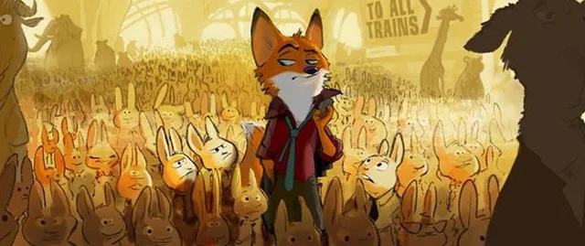
Disney’s Zootopia Explains Anthro Animals
https://www.youtube.com/watch?v=5nP9hU8eUfE

Slide 5
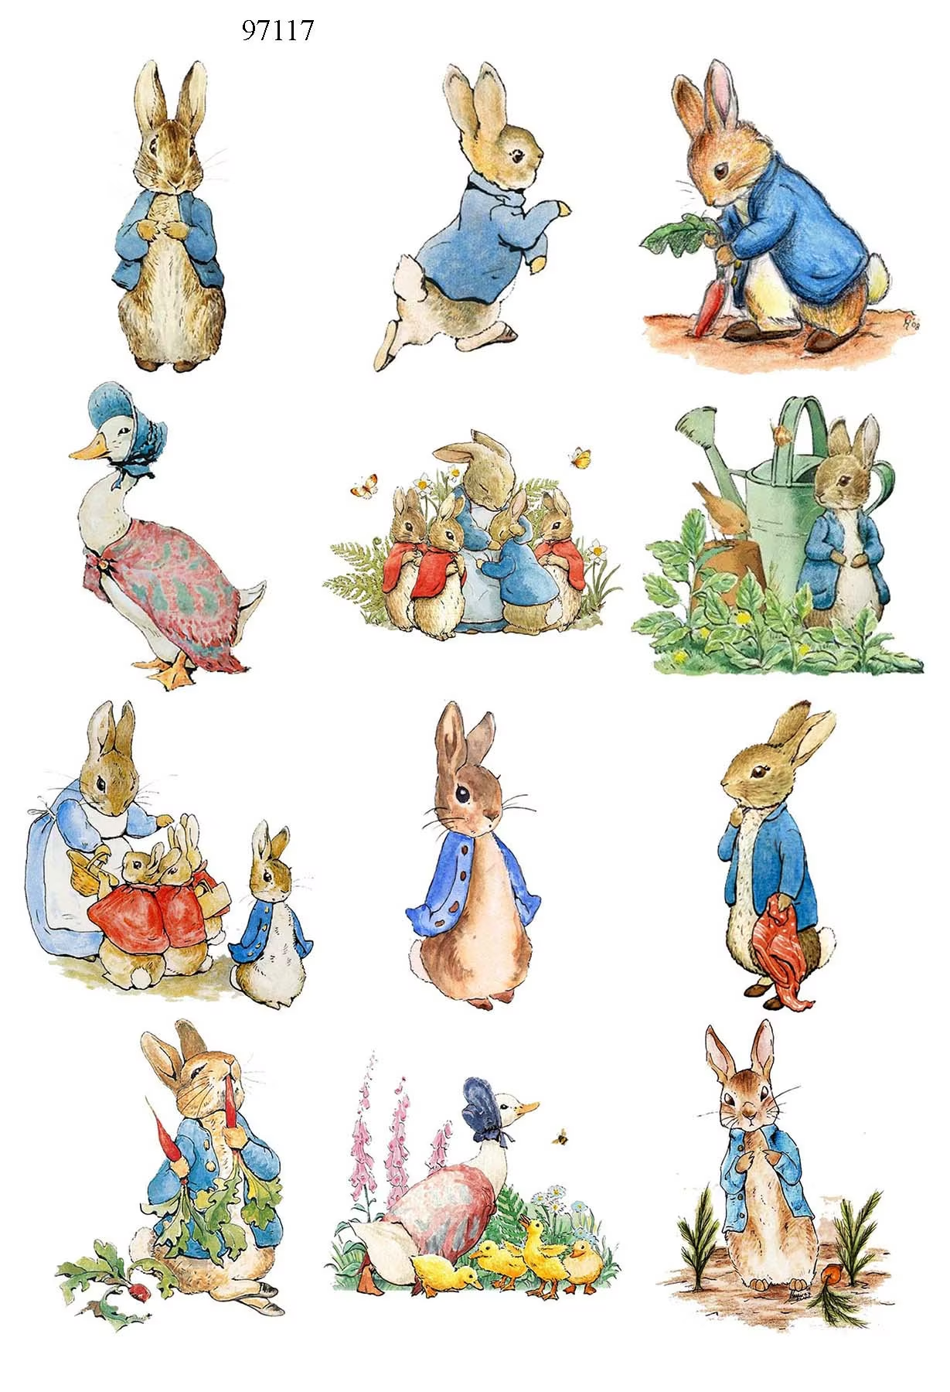
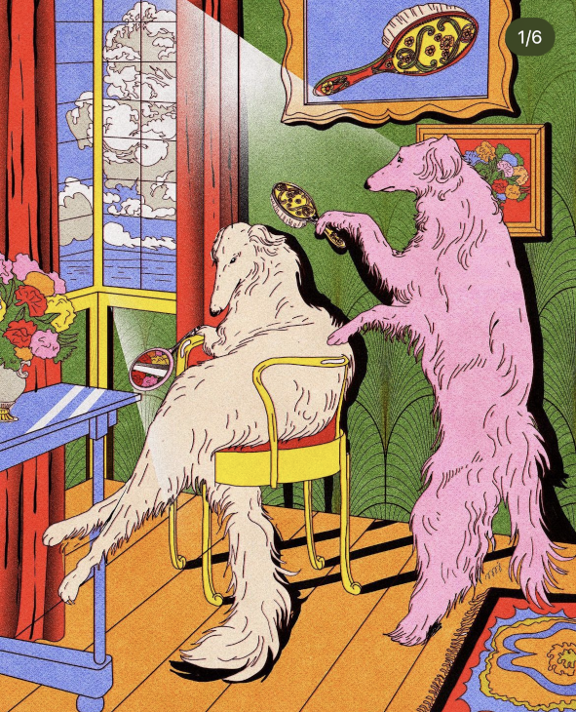
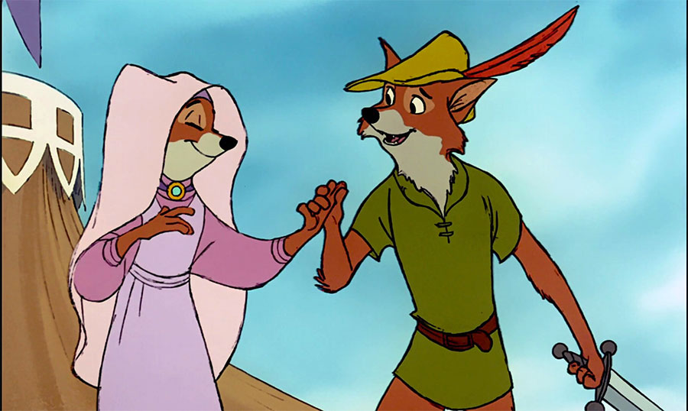
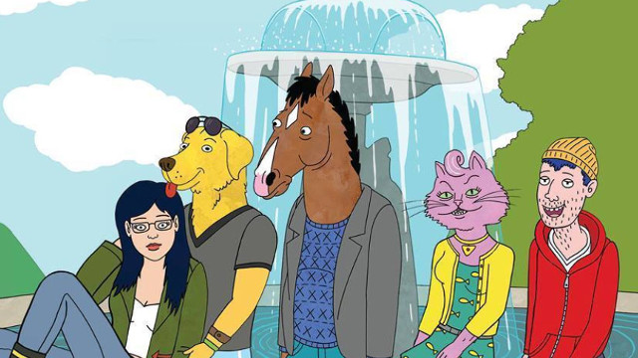
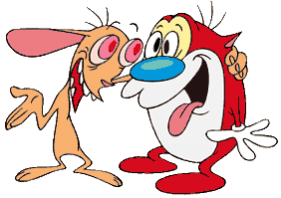
Anthro is everywhere ☺ Many credit Disney as a starting point for interest in the fandom.
(Not limited to mammals! Anthro can be applied to reptiles, birds, insects, objects, etc.)

Slide 6
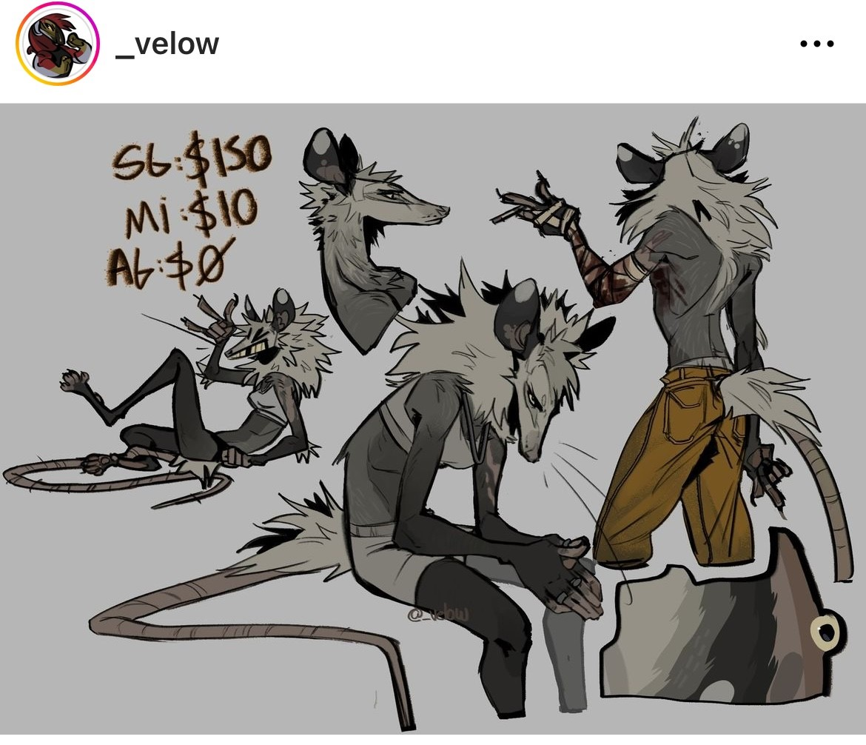
Furries and the Internet:
Furries are unavoidable online:
Social communication:
Twitter, Instagram, Facebook, VRChat
Blogging and documenting:
YouTube, Reddit, Vimeo, etc.
Creative communication and market:
Etsy, Furraffinity, Deviantart, etc.

Slide 7
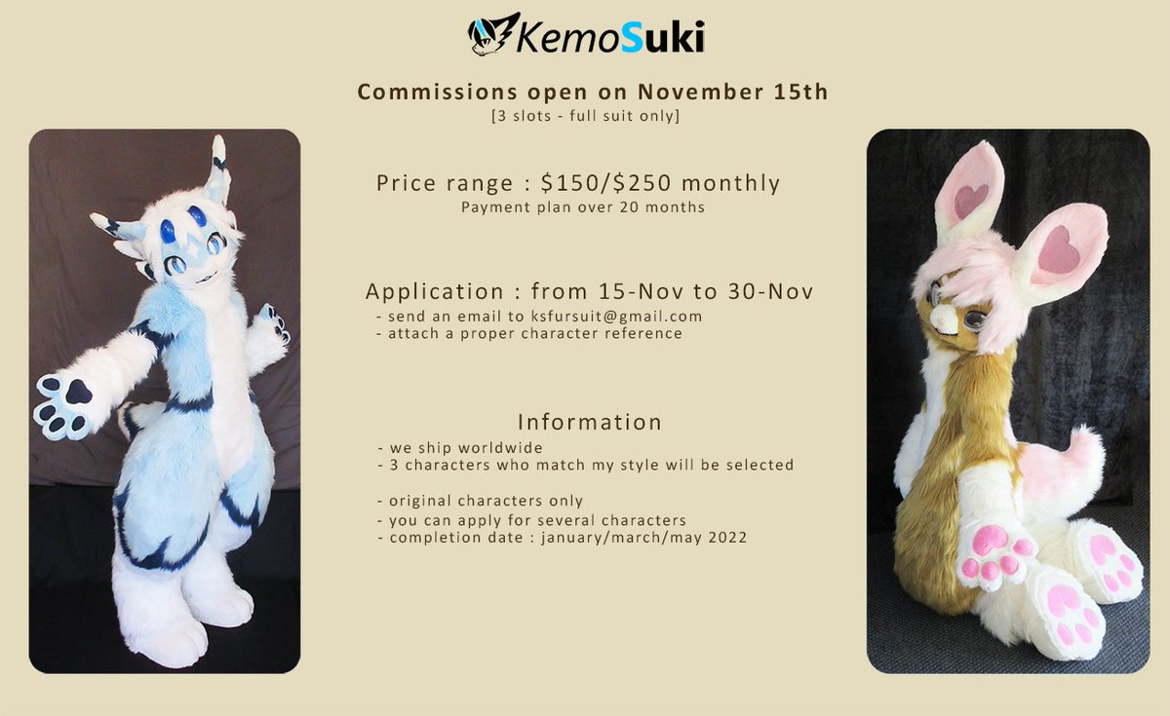
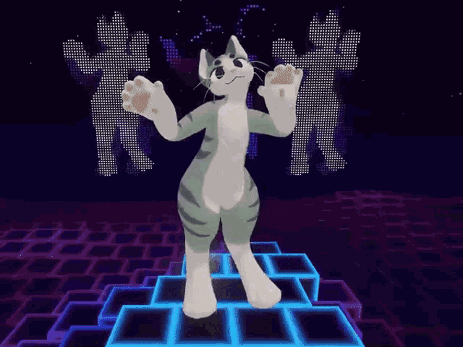
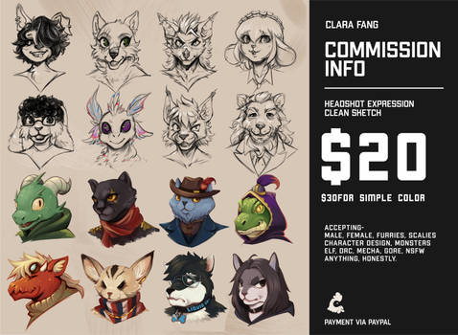
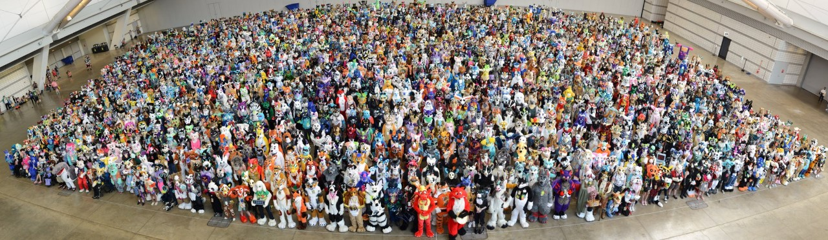

Slide 8
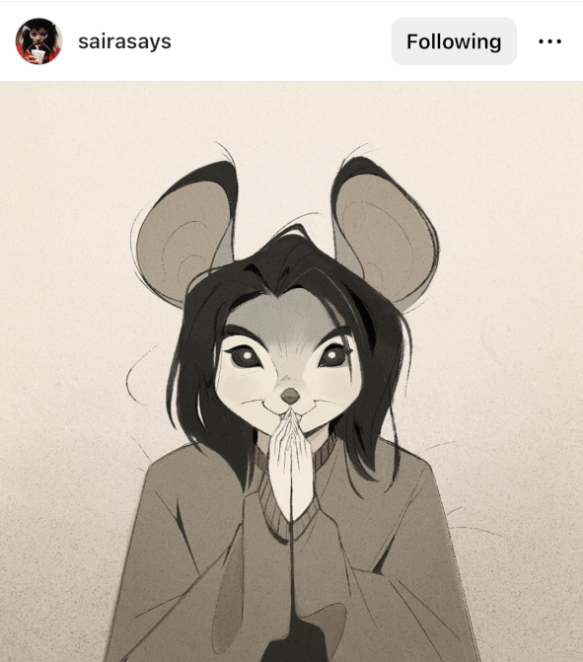
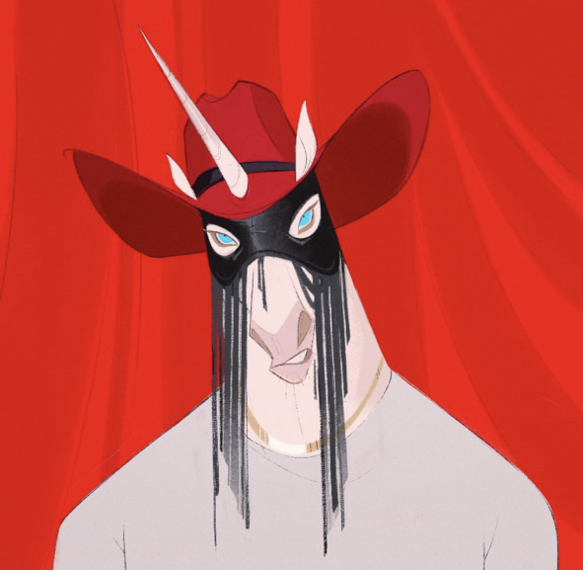
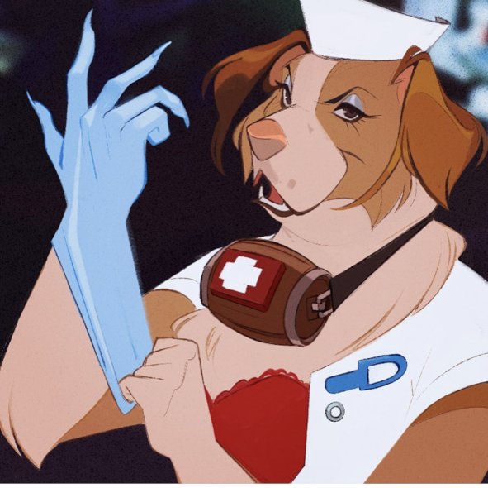
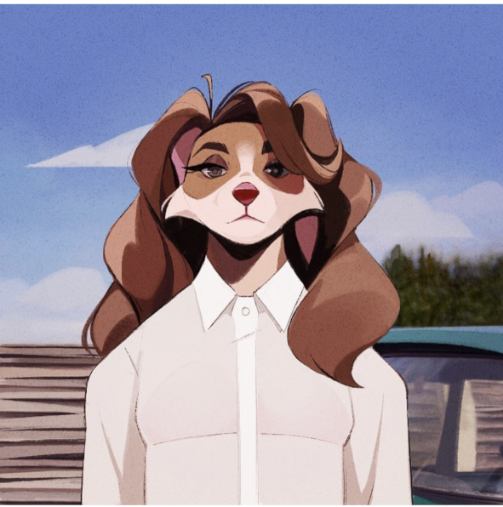
Fursona: A personalized furry character that acts as your identity in the furry fandom
OC (Original Character): A character of any kind created by you (used in a wide range of fandoms and subgenres)
Orville Peck
Blink-182
Lana Del Rey
Bjork

Slide 9
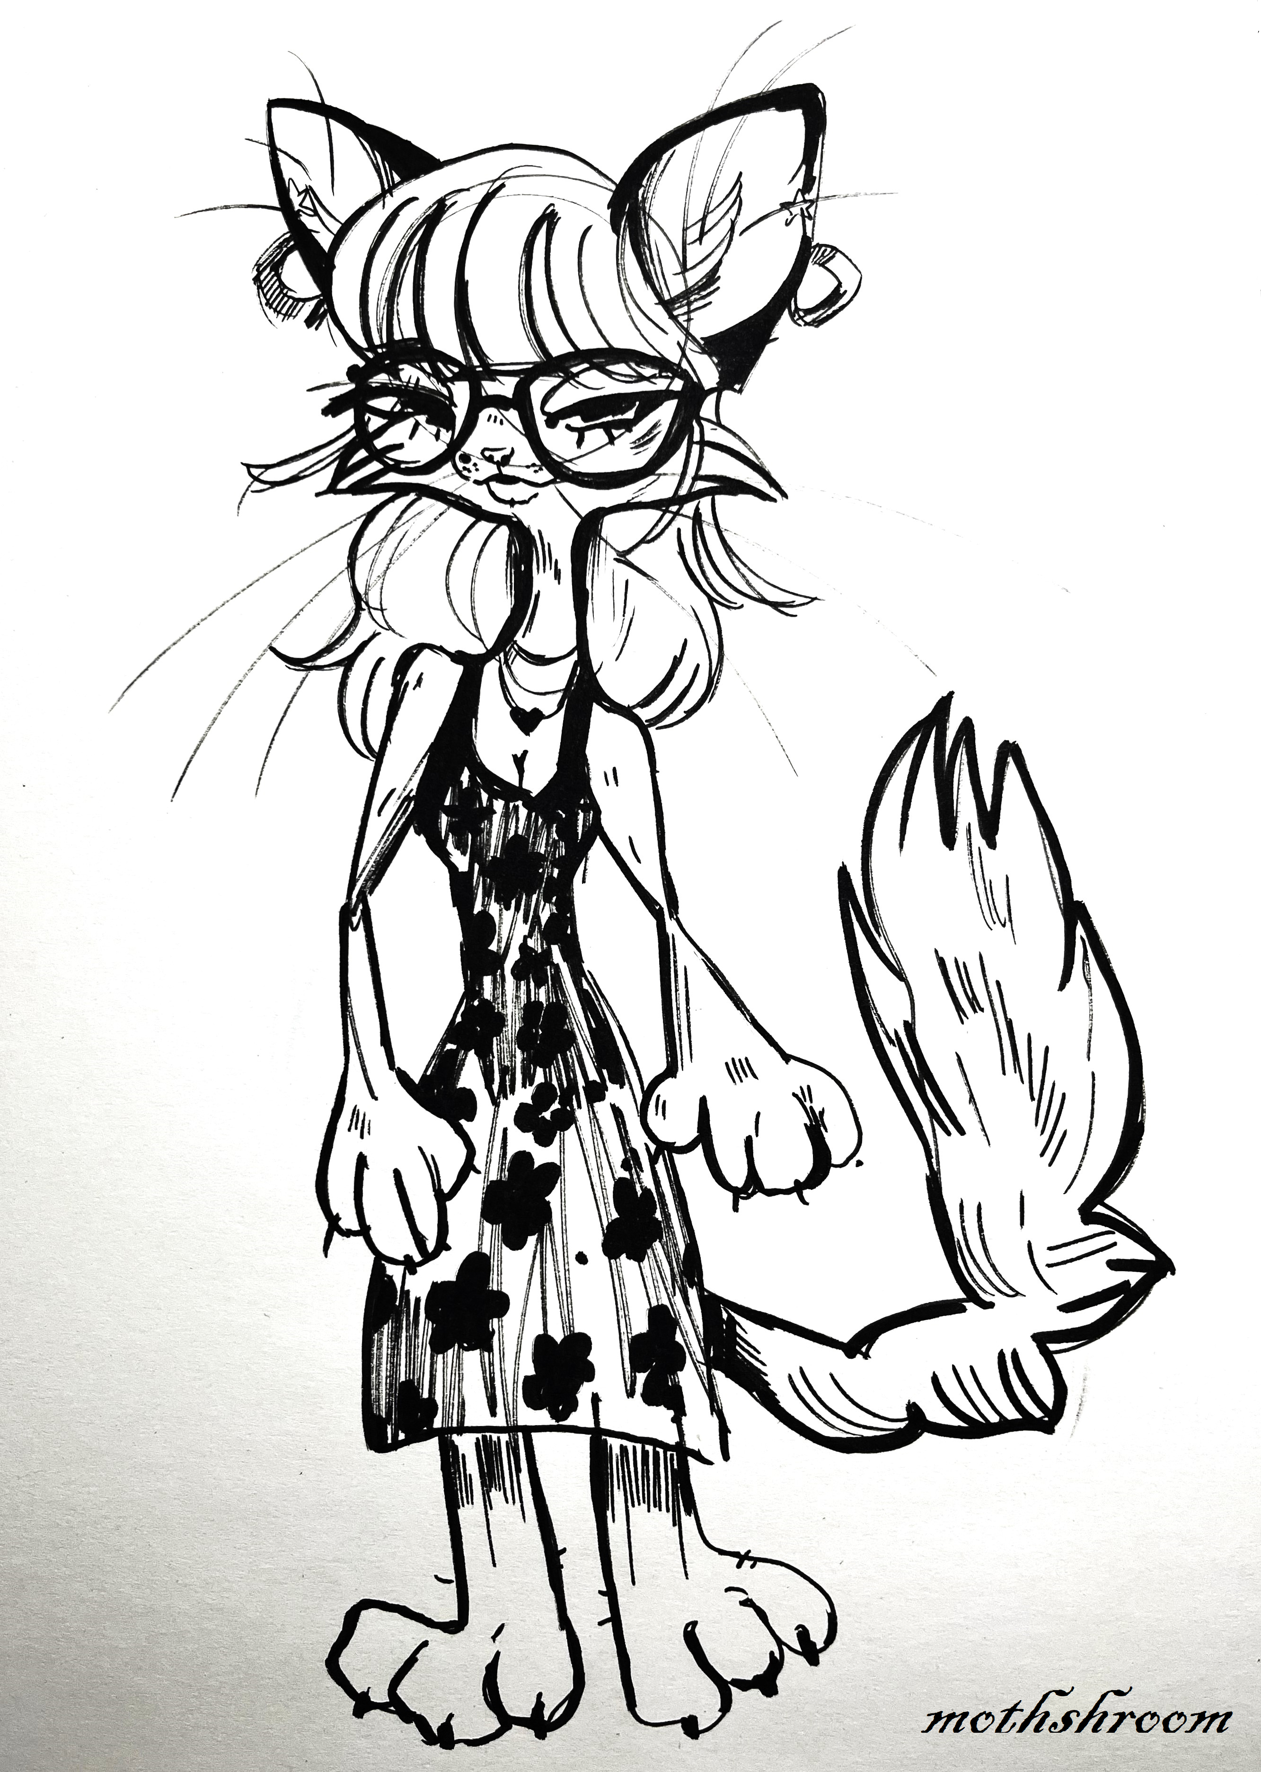
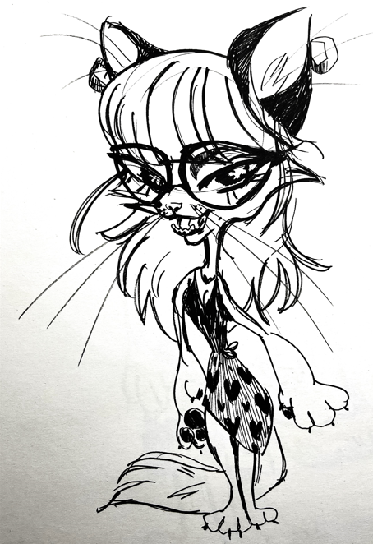

Slide 10
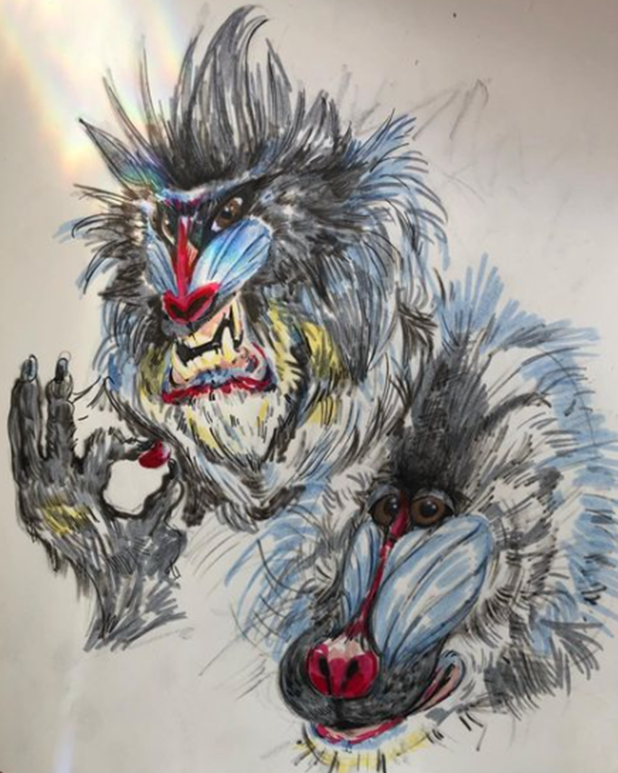
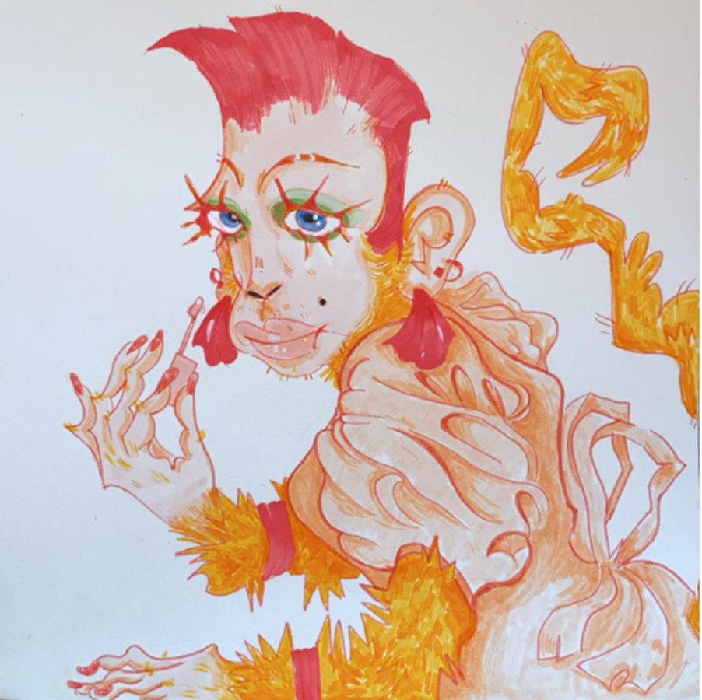
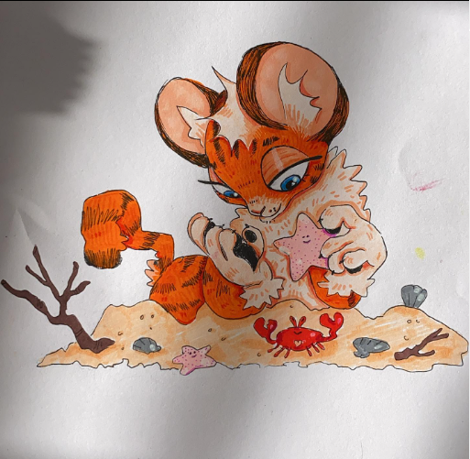
Original Characters

Slide 11
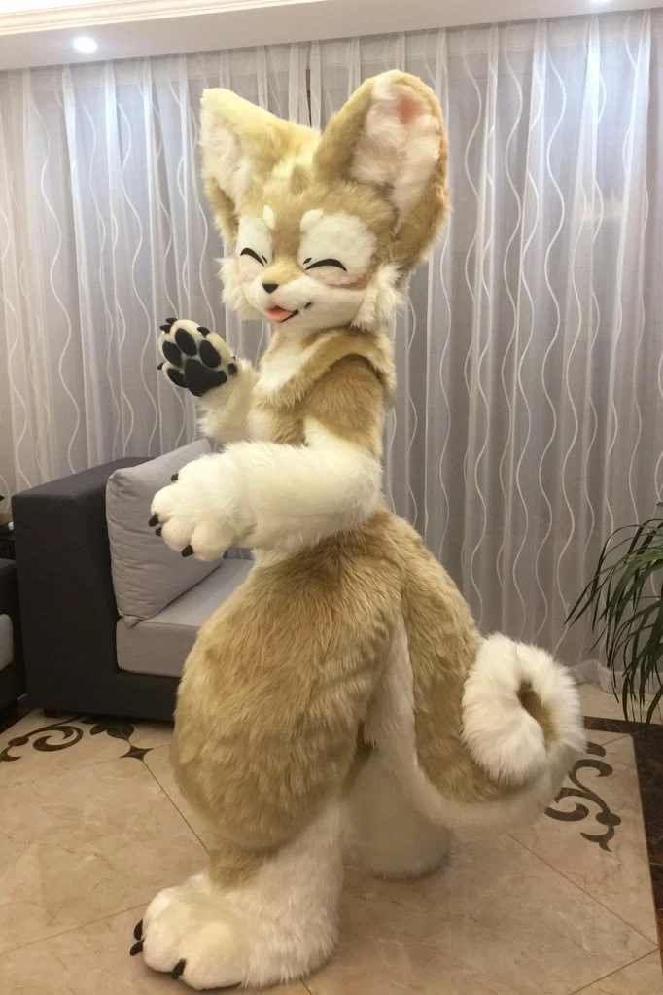
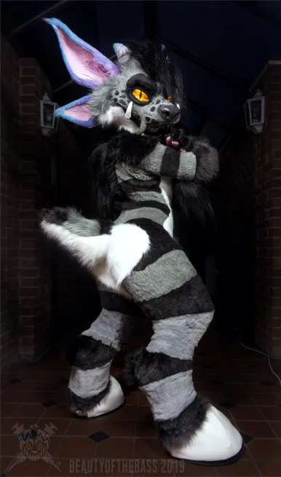
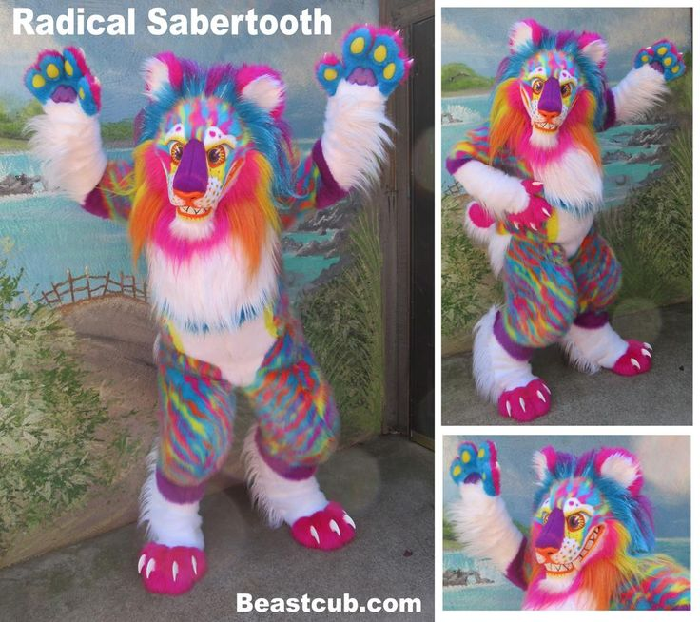
Sold for $14 000 !!!

Slide 12
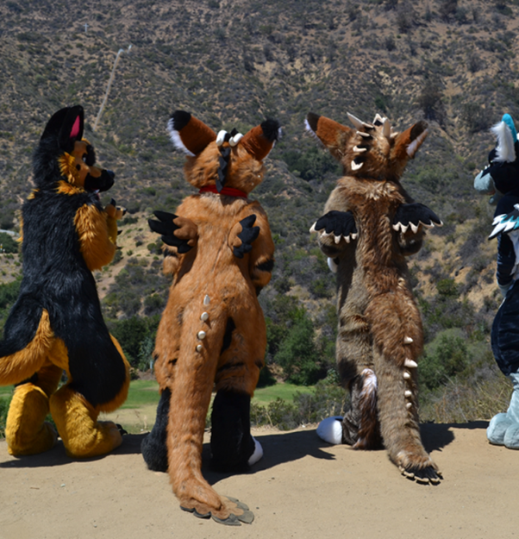
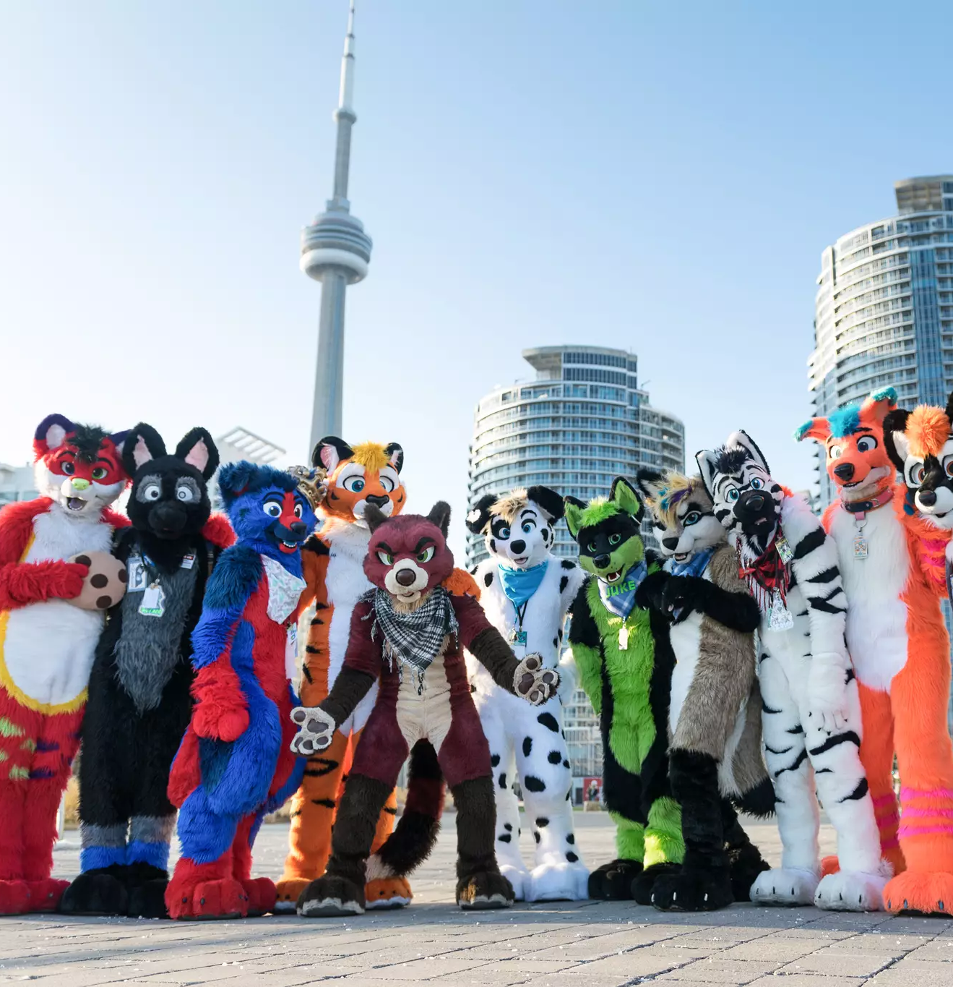

Furry Conventions and Meet-Ups:
Like Comic-Con, furries hold giant conventions to build community
Consists of art, dance competitions, music, fursuiting, meet-and-greets, etc.

Slide 13
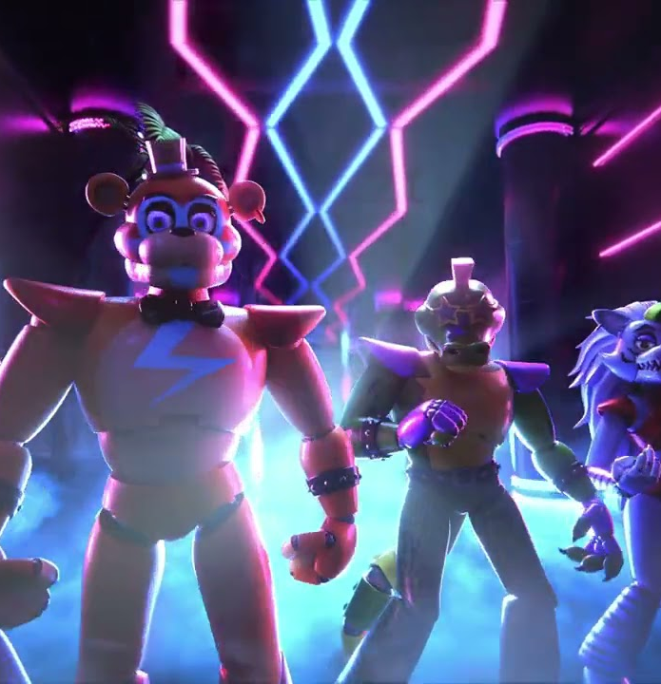
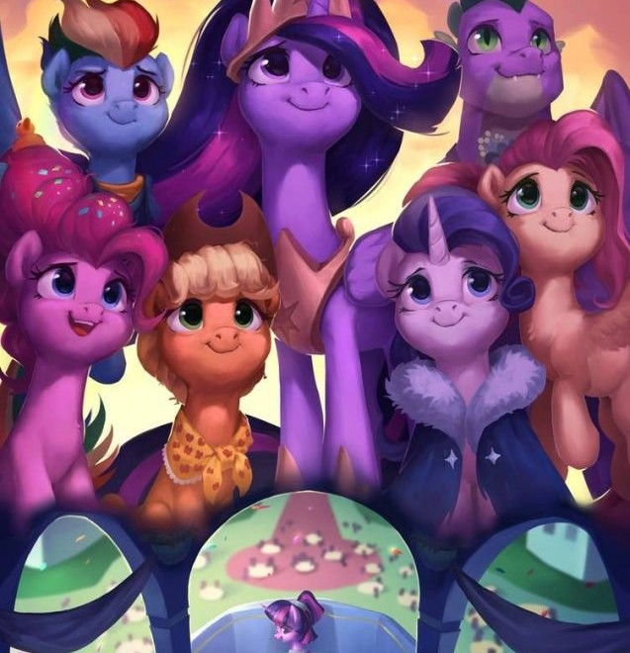
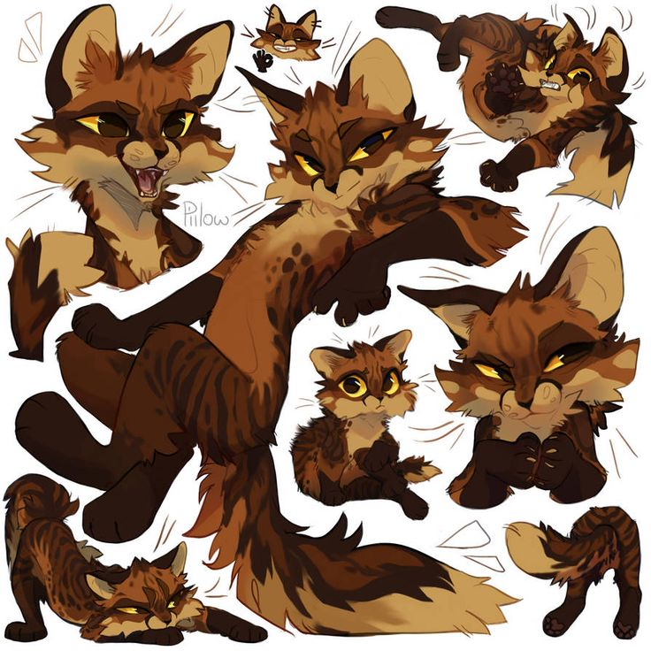
Fandoms within the Furry Subculture
- Five Nights At Freddy’s
- My Little Pony: Friendship is Magic (Bronies)
- Warrior Cats
- Etc.

Slide 14
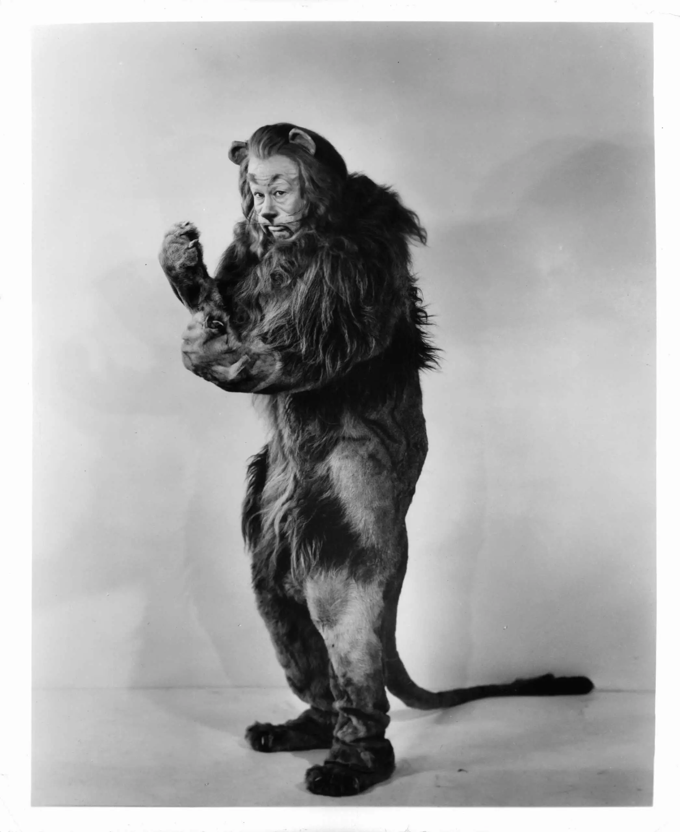
Is the Cowardly Lion a furry?
Debate amongst yourselves.
Thanks for enduring!! ☺

