Slide 1
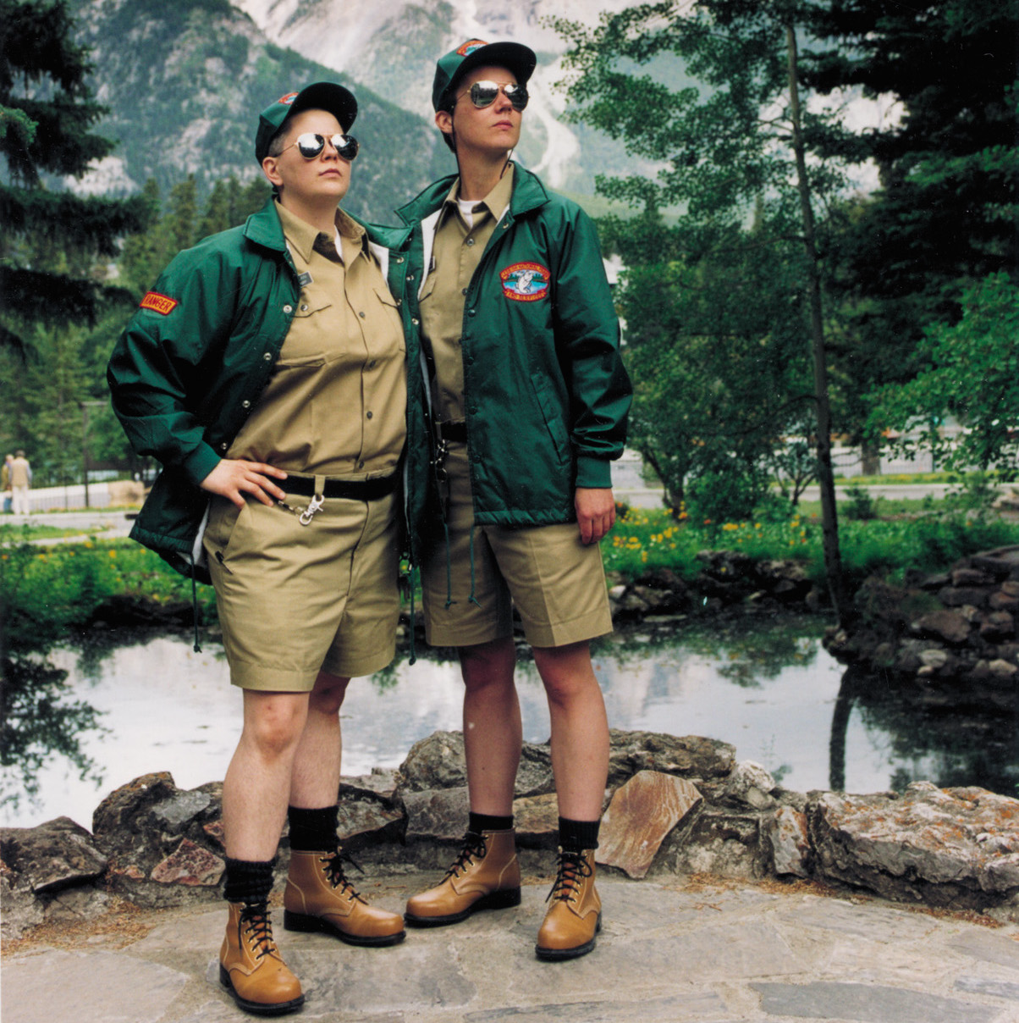
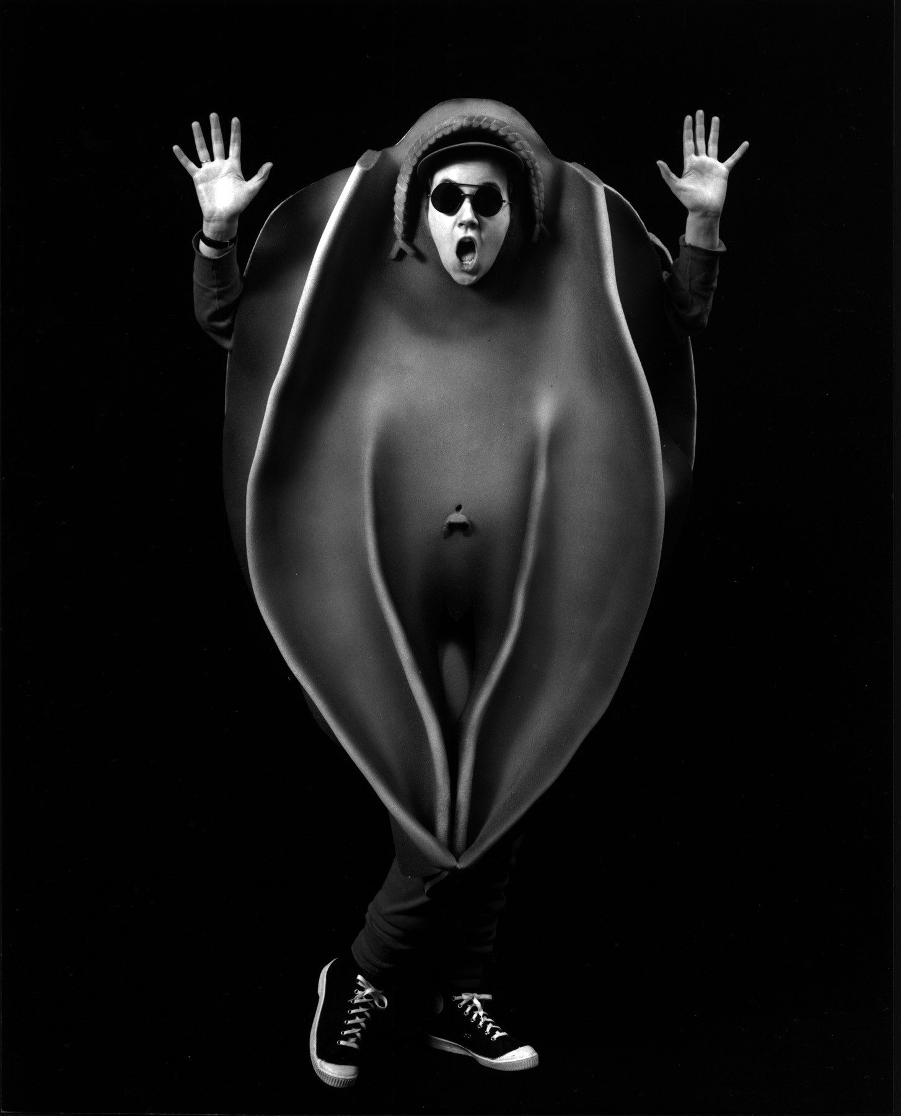
Shawna Dempsey & Lori Millan

Slide 2
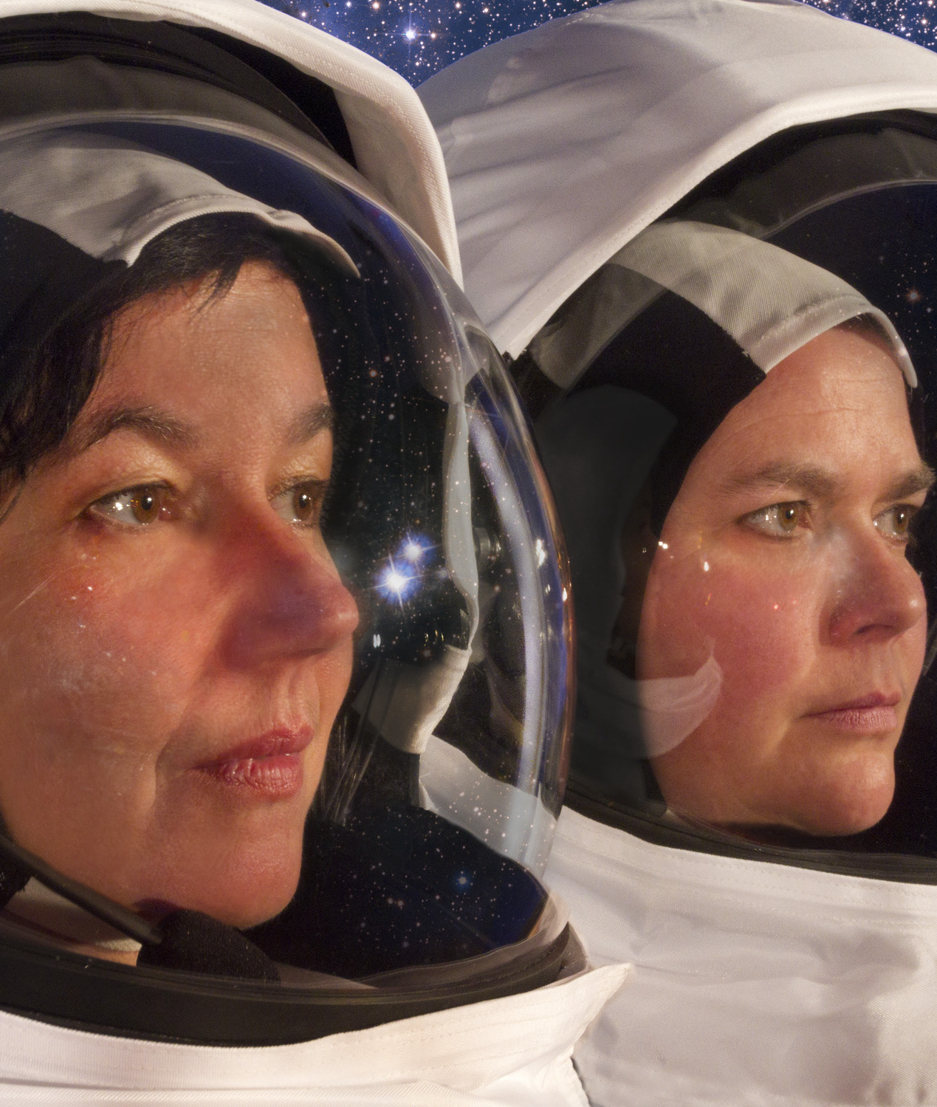
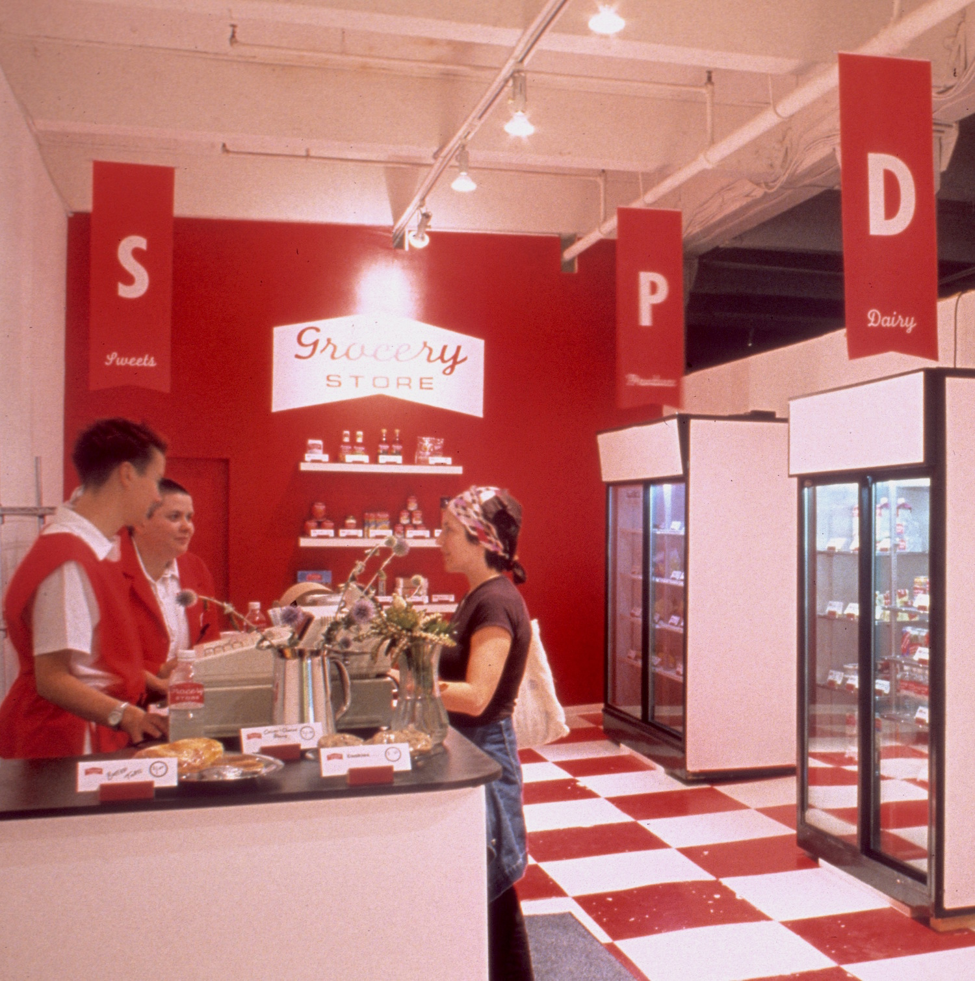
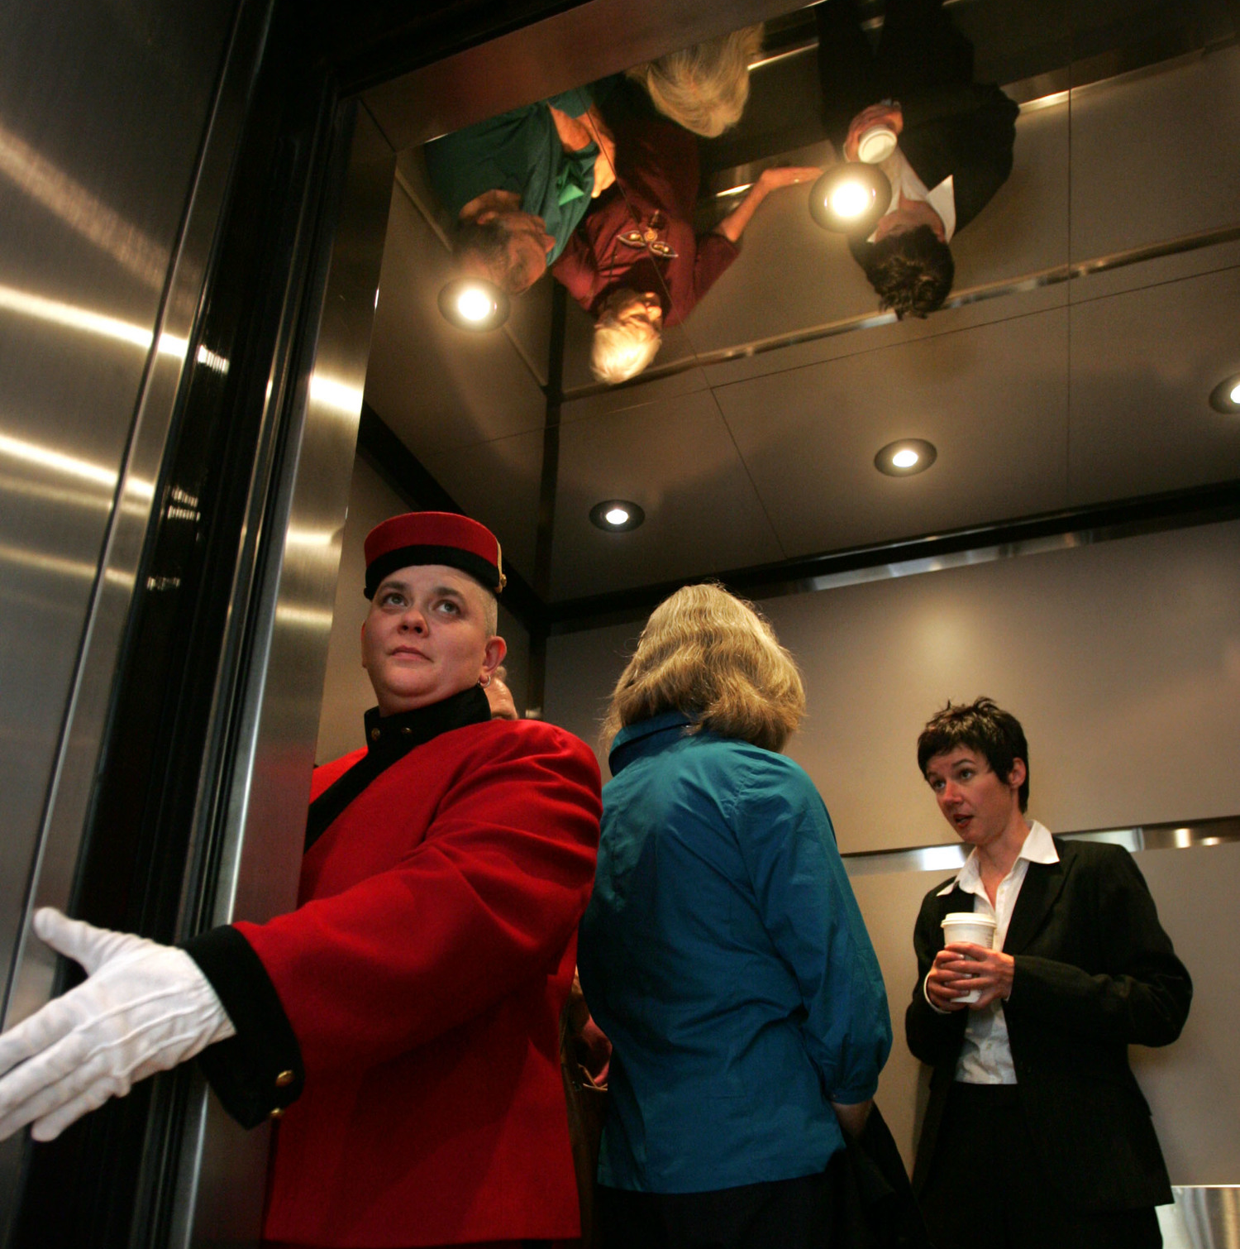
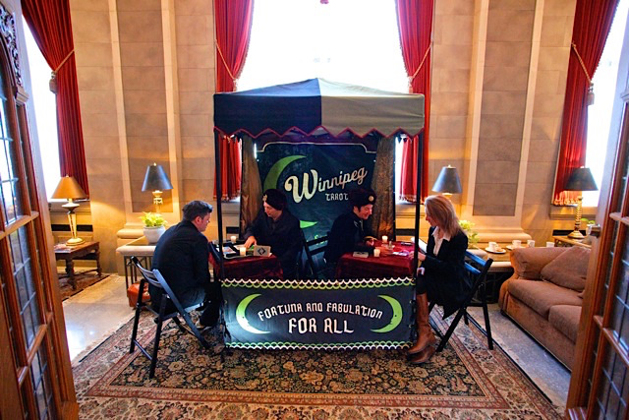
The Artists
Winnipeg-based, multidisciplinary artists, working in performance, installation, public art, film, and books.
Their collaborative practice is humourous and often provocative, addressing themes surrounding feminism and queerness through a lesbian lens.
Their performances often occur in real life as humorous disruptions. The artists take on the personalities of absurd characters to subvert everyday narratives. They use humour as a tool in conveying their point.

Slide 3
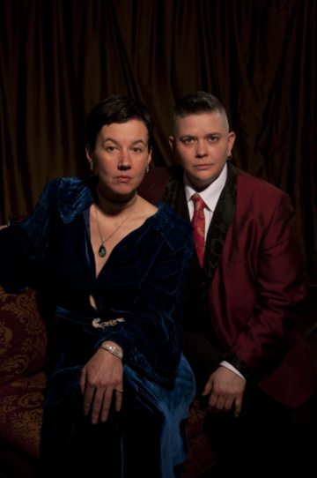
The Art
Dempsey and Millan achieved recognition from their music video We’re talking Vulva from the Canadian short film anthology Five Feminist Minutes (1990).
Other works include Astroart Space Corps, Lift, Grocery Store, Winnipeg Tarot Company, and Lesbian National Parks and Services

Slide 4
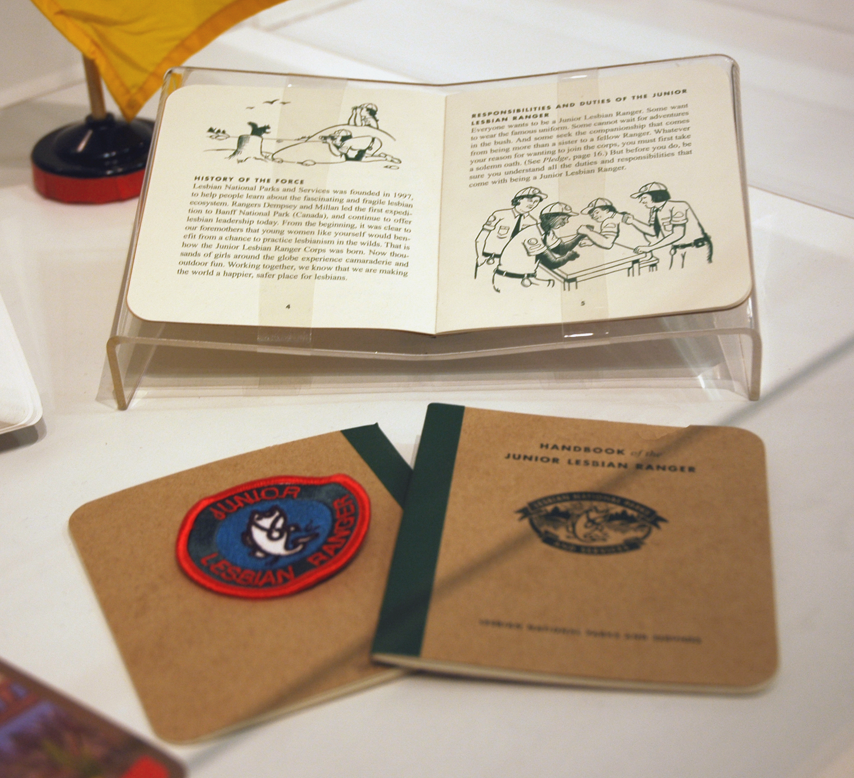
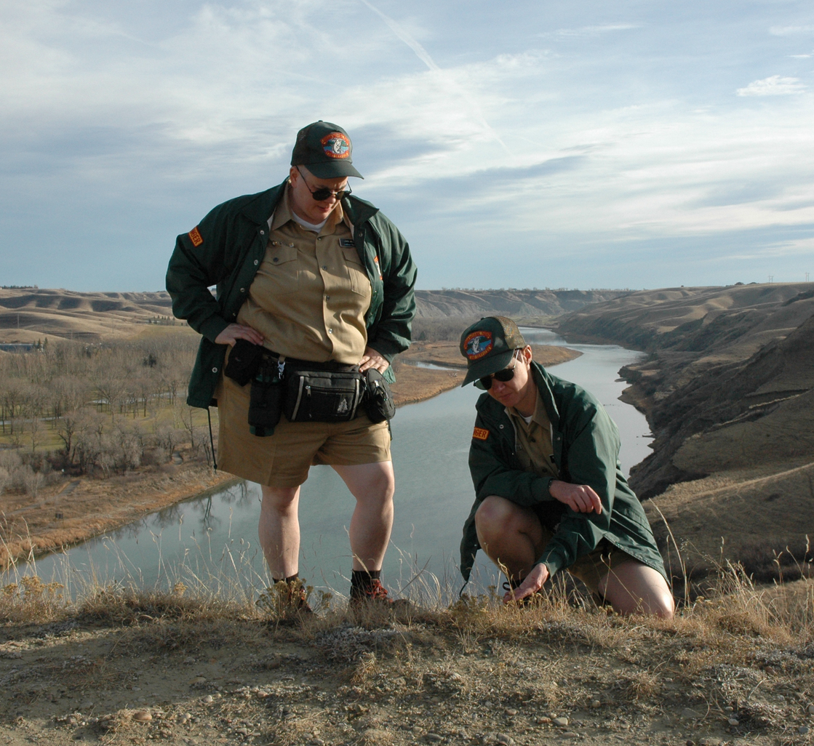
Lesbian National Parks and Services
Lesbian National Parks and Services (1997) remains one of their most well known work. The performance saw Dempsey & Millan in costume as Lesbian Rangers patrolling parks, city streets, and universities and interacting with visitors as a sort of “tour-of-duty”. They have also produced brochures, books, postcards, and recruitment videos to accompany the performance.
The outdoors is a political space. Nature in much of Canada and of North America is limited to those who can afford access to transport, protection against the elements, admission, etc. This project seeks to challenge the general public’s ideas of tourism, recreation, and the “natural” environment by injecting a queer presence.

Slide 5
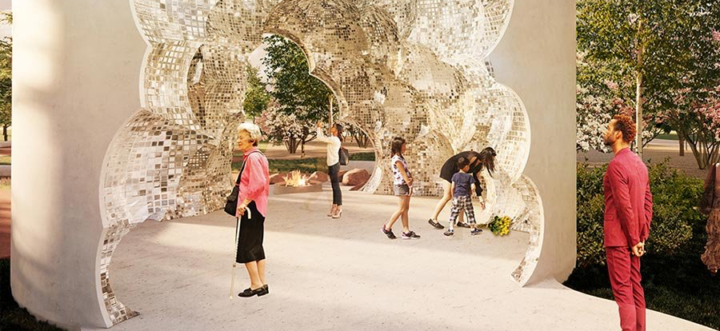
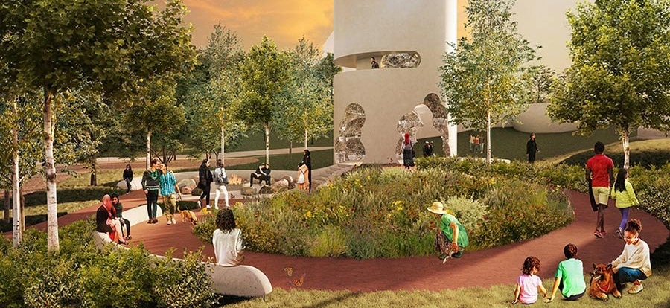
Acclaims
Dempsey and Millan are the recipients of many awards which include the Canadian Museums Association Award for Outstanding Publication and the Manitoba Arts Council Special Prize for Innovation and Excellence
They have exhibited in Sri Lanka, New York, Toronto, Vancouver, Seattle, Istanbul, Lyon, among other locations. Their performance documentation is held in the collections of the National Gallery of Canada, the Dia Art Foundation, and the MoMA.
In March 2022, they were announced to have been chosen to design the future LGBTQ+ National Monument in Ottawa

Slide 6
Why after 30 years their work is still impactful
Funny, sharp, and relevant!
Queer culture has grown as a social movement over the past 25 years. Their works remind us of the struggles many LGBTQ2+ have had to fight against/continue to fight. It also reminds us of the generational legacy of social change.
The duo’s disruptions are joyfully necessary breaks from a disenfranchised system. Their works have created a sense of community, bringing people together through absurd performance.

